Slide 1

Library Management System
Complete SQL-based solution for modern library operations

Slide 2
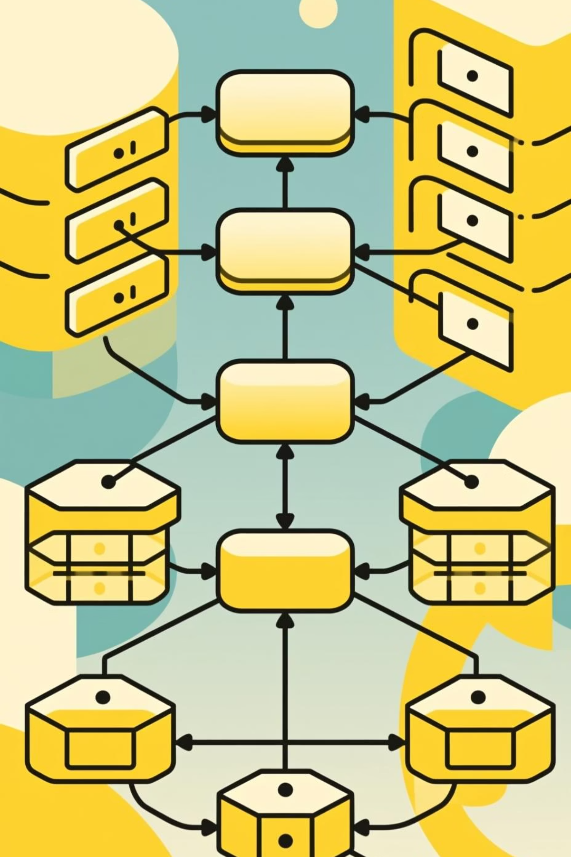

Project Overview
Database Design
Relational schema with 6 core tables
CRUD Operations
Complete record management system
Analytics
Insights and reporting capabilities
Automation
Stored procedures for workflows

Slide 3

Database Architecture
Core Tables
Design Focus
branch
Relational structure ensures data integrity and efficient querying across all library operations.
employees
members
books
issued_status
return_status

Slide 4
Core Functional Features
01
02
Record Management
Issue & Return Handling
Insert, update, delete operations for all library records
Automated workflows with validation constraints
03
04
Availability Tracking
Branch Insights
Real-time book status monitoring
Operational analytics per location

Slide 5

Analytical Capabilities
1
Member Activity
Track members with multiple issues
2
Revenue Analysis
Category-based revenue reporting
3
Outstanding Books
Monitor unreturned items
4
Issue Frequency
Popular titles and demand patterns

Slide 6

CTAS Implementation
Created Datasets
Issue Frequency Table
Reporting on book circulation patterns
Branch Summary
Operational metrics by location

Slide 7



Stored Procedures
add_return_records
Automates return processing and updates book availability status
issue_book
Validates availability and executes complete issuing workflow

Slide 8
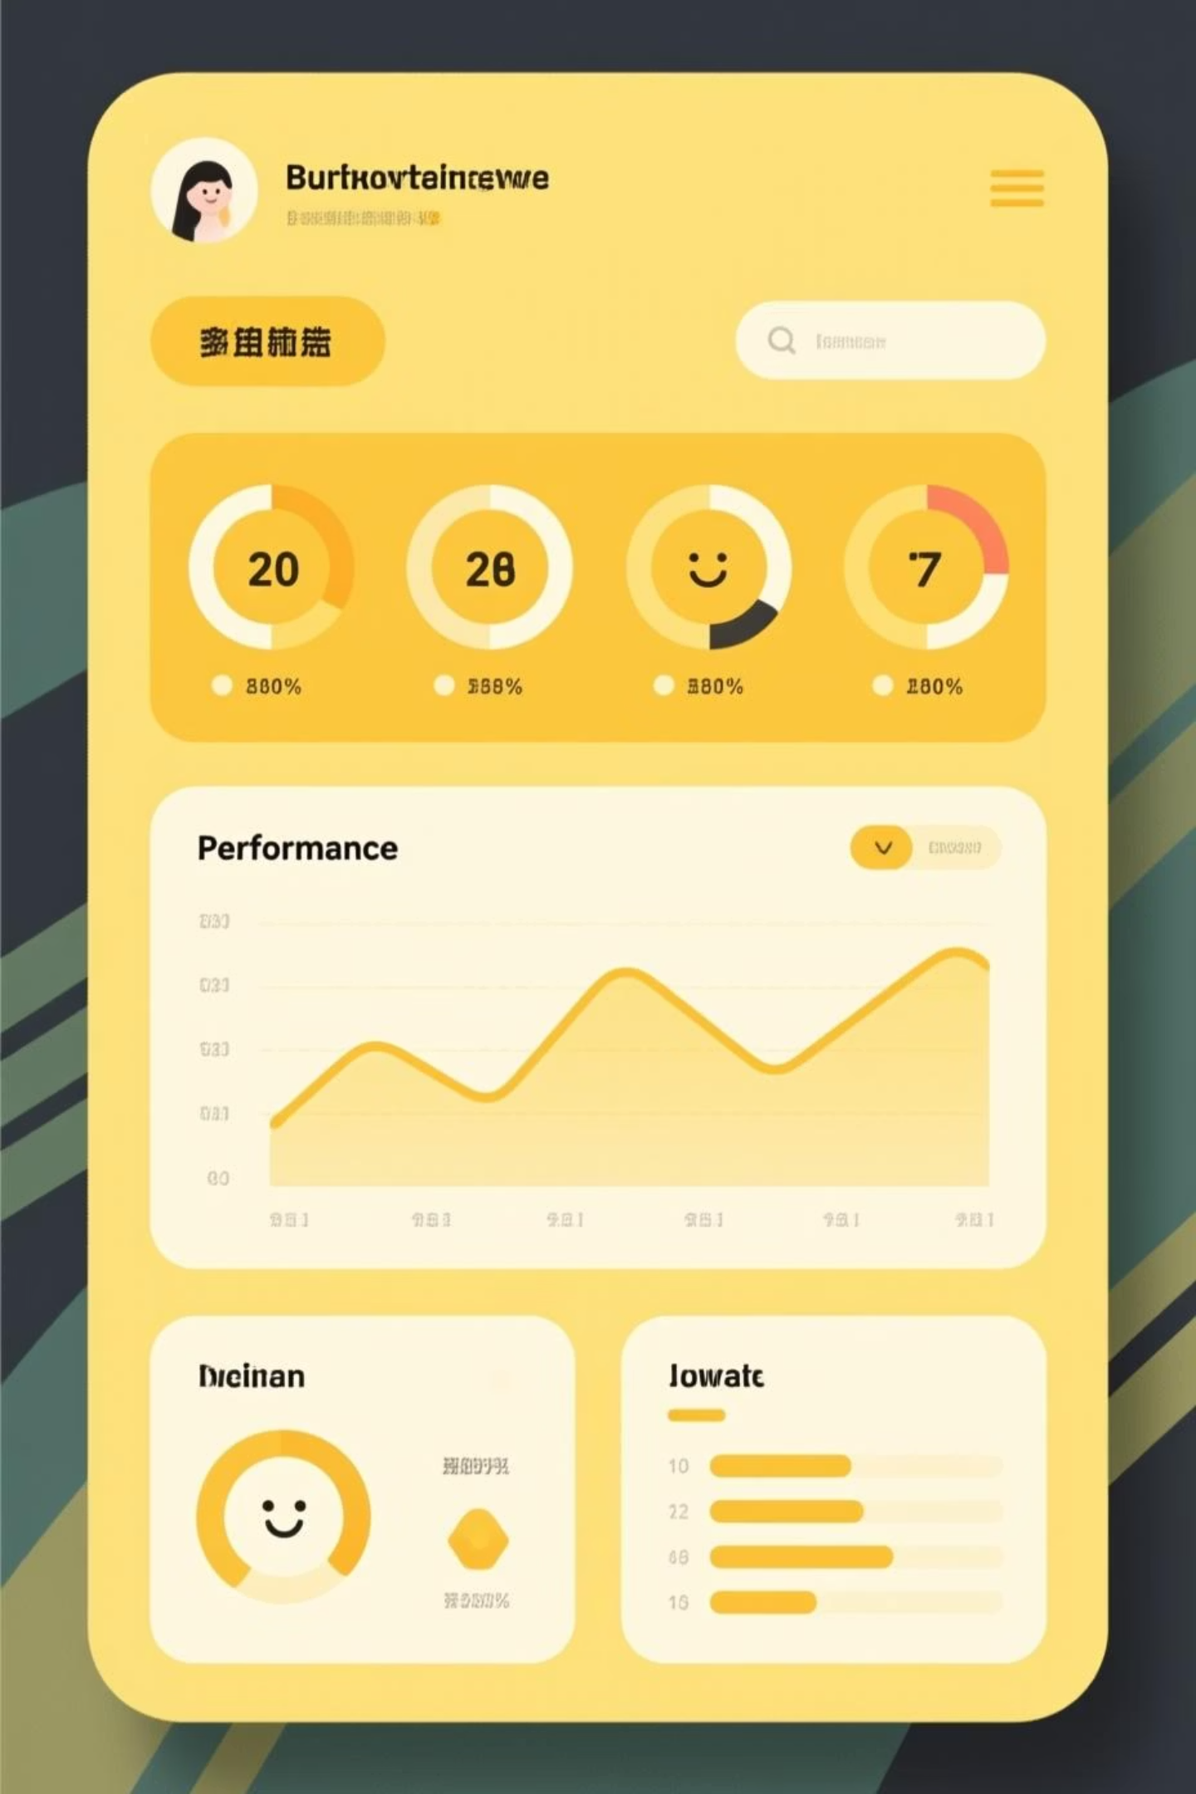
Branch Performance Dashboard
3
100%
24/7
Key Metrics
Operational Visibility
Data Access
Issues, returns, revenue per branch
Always-available reporting
Real-time performance tracking

Slide 9
System Capabilities
Real-World Design
SQL Proficiency
Production-ready relational database architecture
Advanced queries, joins, and optimization
Reporting
Automation
Comprehensive analytics and insights
Procedures for workflow efficiency

Slide 10

Portfolio-Ready Project
Interview Assessment
Real-World Application
Demonstrates SQL expertise and problem-solving
Practical system with business value
Technical Depth
Complex queries, procedures, and optimization

